Slide 1

Retail Challenge
Data Scientist – Laura Le

Slide 2

Business Context
About the Business:
- UK gift supplier with 1M+ transactions (2009-2011).
- Serves wholesalers, retail stores, and resellers.
- High business volume during UK holiday seasons (October – December)
Challenge:
- Understand customer data, sales, and opportunities.
- Accurate sales forecasting.
- Address cancellations and returns.
Key goals:
- Analyze data, gain insights.
- Implement customer segmentation.
- Develop forecast models.
- Present results.
Notes:
To start with the online retail project, I'll provide a snapshot of the business context, the challenge, and the objectives.
The business, based in the UK, specializes in unique all-occasion gifts and mainly serves wholesalers and resellers.With a significant volume of transactions occurring between 2009 and 2011, this company is particularly active during the peak holiday seasons from October to December.
The challenge is to analyze customer data and sales history to identify key market segments and enhance sales predictions. I’m also accounting for cancellations and returns in my analysis. . The end goal is to increase profitability by optimizing sales and reducing return impacts.

Slide 3
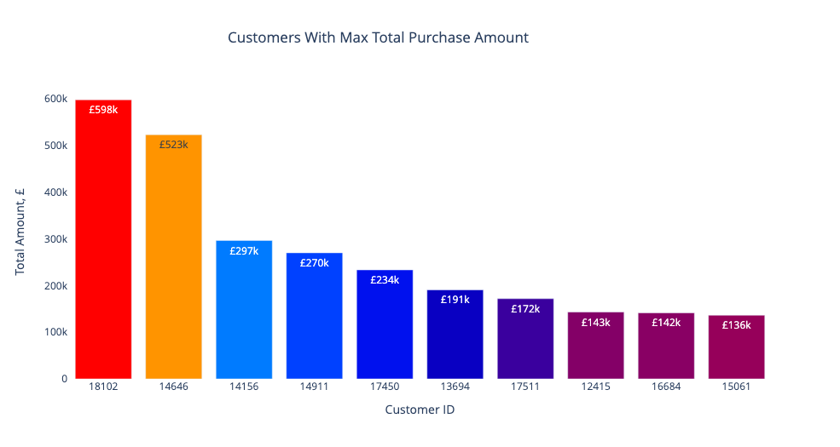
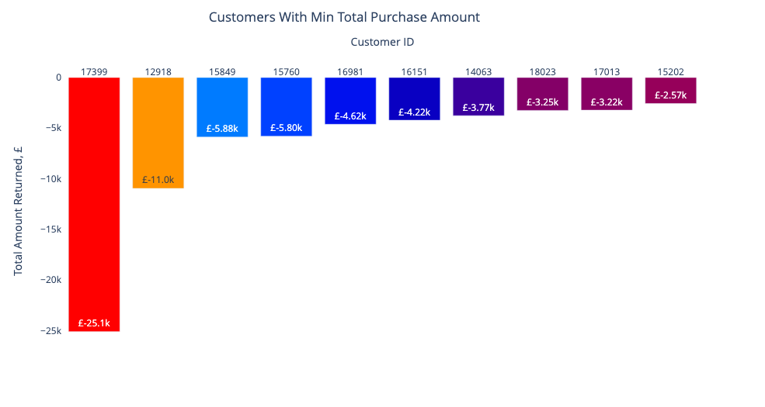
Customer Analysis: Total Purchase Amount
Sales Highlights:
- Highest spender: ID 18102 (UK) at £598k.
- Next: Netherlands customer at £523k.
- Top 10 mainly from UK, EIRE, Netherlands, Australia.
- Largest return: UK customer with £25k.
- Key observation: Top spenders and returners come from similar countries.
Notes:
First step in data exploration is Examining total purchases by customer, our top spender is a Customer from UK with £598k over two years. Following closely is a patron from Netherlands. our top 10 spenders largely come from UK, EIRE, Netherlands, and Australia.
On the flip side, we see negative amounts indicating returns. The highest is £25k from a UK customer. Interestingly, countries with the top spenders also have the significant returns.

Slide 4
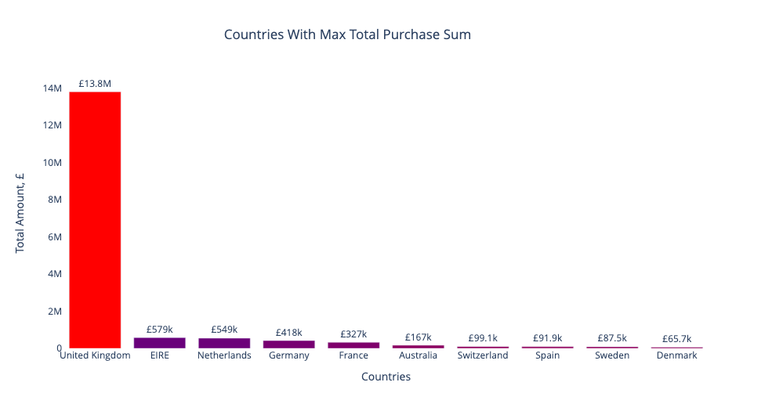
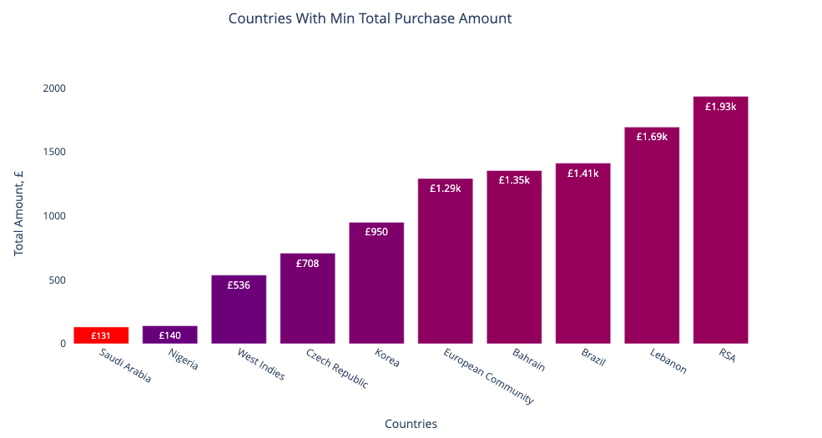
Country Analysis: Total Purchase Amount
Sales Highlights:
- UK leads with £13.8M in purchases.
- EIRE follows at £579k, 23x less!
- Top ten countries all in Europe.
- Lowest spender: Saudi Arabia (£131 in 2 years).
- Notable exception in Europe: Czech Republic.
Notes:
Let's delve into the total purchase amount by country. Dominating the charts, we have UK, with £13.8M in purchases. A fascinating observation is that the top ten spenders are all located within Europe.
On the flip side, Saudi Arabia is the smallest spender, with £131 over two years.

Slide 5
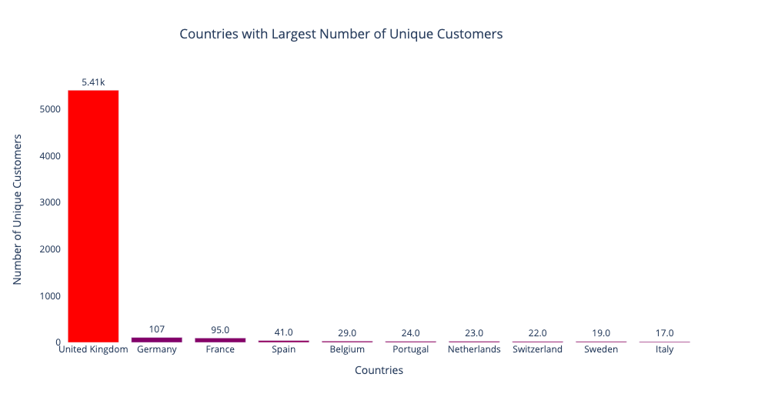
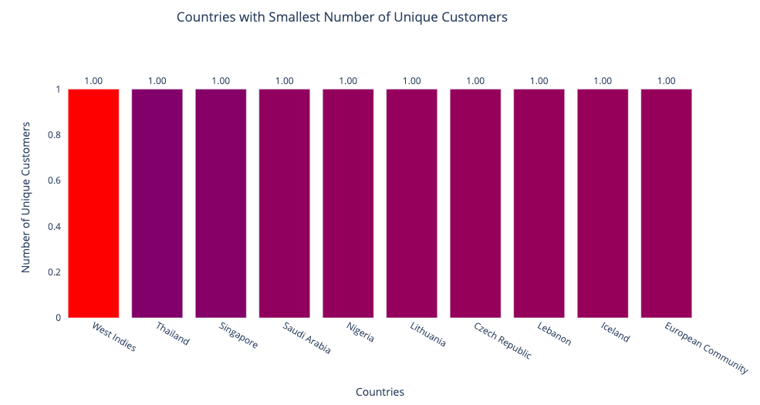
Country Analysis: Unique Customers
Customer insights:
- UK dominates with 5.41k.
- Germany and France come next with 107 and 95 respectively.
- Several countries, including Thailand and Nigeria, have only one customer.
- Single-buyer anomalies in Europe: Czech Republic, Lithuania, European Community.
Notes:
Turning our attention to unique customer by country, UK stands out with 5.4k customers making purchases in the last two years. while Germany and France, have only around 100 customers.
Now, diving deeper, I find a variety of countries, from Thailand to Nigeria, and even Saudi Arabia, have just one customer recorded.

Slide 6
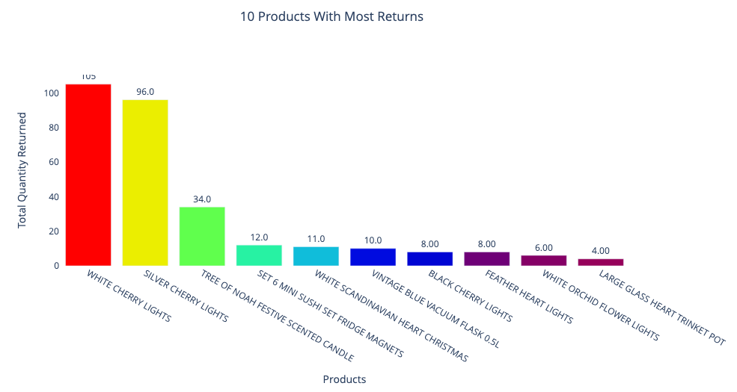
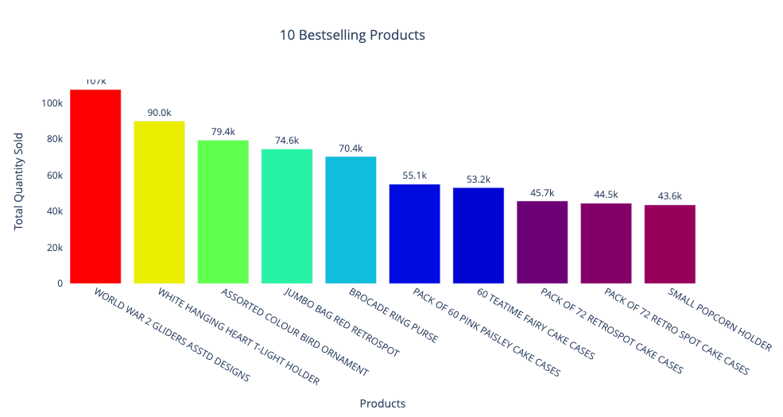
Product Analysis: Quantity
Product Quantity Analysis:
- Bestseller: World War II Gliders (107k in 2 years).
- Top 10 includes: Holders, cake cases, a purse, and jumbo bag.
- Most Returns: White Cherry Lights (105 returns in 2 years).
- Return List Dominance: Decor items and gifts - candles, flasks, pots, magnets, and lights.
Notes:
About product, The standout performer is World War II Gliders, with over 100,000 units sold in just two years. everyday items like cake cases, holders, purses, and jumbo bags are also amongst the bestsellers.
on the topic of returns, The White Cherry Lights lead this category with around 100 units returned. Interestingly, several decorative items such as candles, flasks, and magnets also appear frequently.

Slide 7
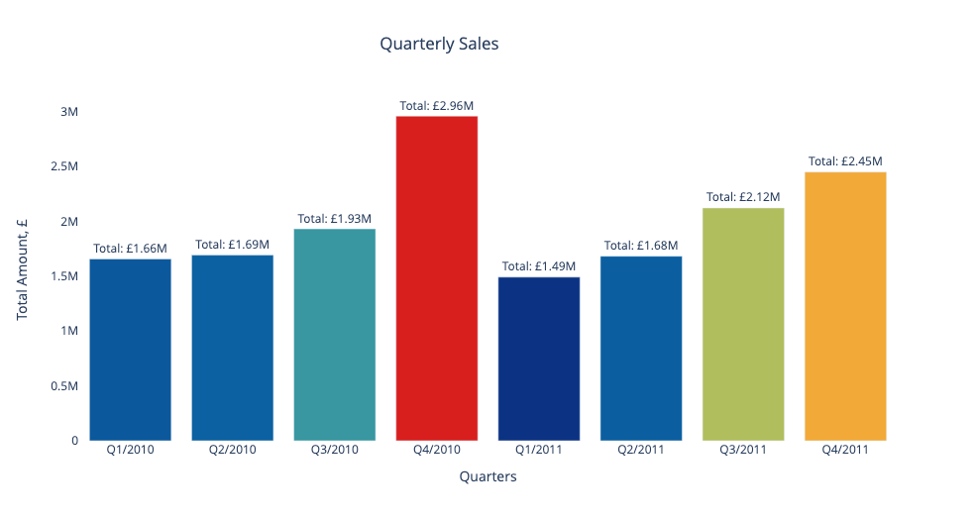
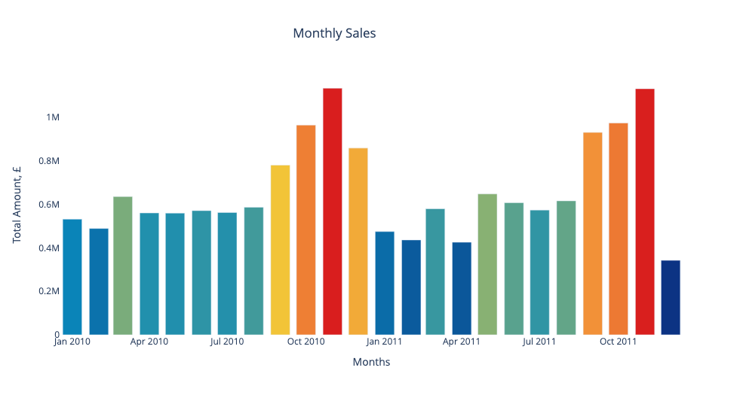
Online Sales Timeline
Sales Trend Insights:
- Seasonal spikes evident, particularly pre-Christmas.
- Post-holiday dip observed.
- Significant decline: December 2011 sales just half of December 2010's.
Notes:
Looking at sales timeline data, the seasonal trends are clear. We see a surge in purchases leading up to Christmas, followed by a decline. When we zoom in, these holiday spikes become even more pronounced. But here's something interesting: December 2011's sales were just half of what we saw in December 2010. A dramatic decrease year-over-year.

Slide 8
Data Preprocessing Steps
Data cleaning: Keep rows with price > 0, remove duplicated records
1
Handling missing values: drop 22% of the rows have a missing value for the Customer ID
2
Feature Engineer: calculate total value of each transaction:
Total = price * quantity.
3
Notes:
Before diving into the segmentation and modeling, I have preprocessing steps to ensure the data is ready for analysis.
1. The first step is data cleaning. any rows where the price is not positive, or any duplicated records, were removed. This ensures that I work with clean, non-redundant data.
2. next, handle missing values in dataset is crucial. I observed that 22% of the rows had missing values for the 'Customer ID'. In order to maintain the integrity of my analysis, these were dropped.
3. Lastly, I optimized the data by introducing a new feature, calculating the total value of each transaction by multiplying the 'price' and 'quantity'.

Slide 9
RFM analysis
Segment customers based on their purchase patterns by grouping them based on their previous purchase transactions, with 3 quantitative factors:
Recency: How recently a customer has made a purchase
Frequency: How often a customer makes a purchase
Monetary: How much money a customer spends on purchases
Notes:
To understand customers’ purchase patterns, we begin with RFM analysis. RFM segments customers based on their buying behavior, considering recency, frequency, and monetary value. Recency measures recent purchases, Frequency measures consistency, and Monetary assesses spending. This foundation provides a quantifiable view of customer behavior, enhancing advanced segmentation.

Slide 10
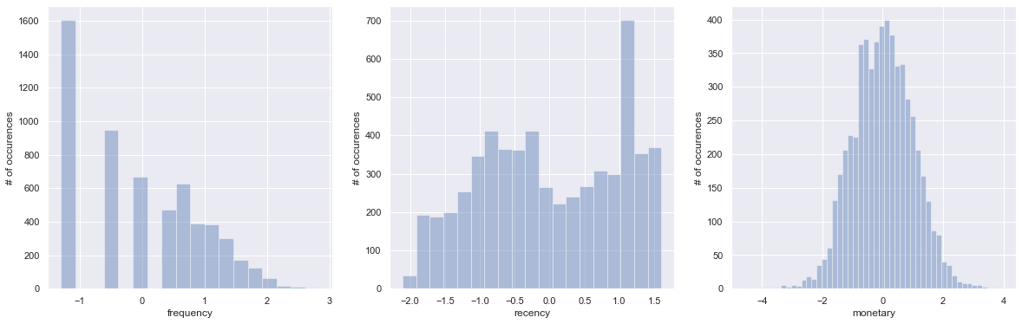
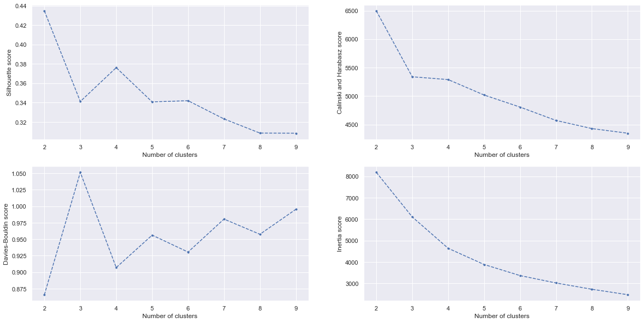
K-means Clustering
- Standardize the variables to get symmetric distribution.
- The plots from different metrics all suggest that the best number of clusters is 4
- K-means compute and assign the clusters for each customer.
Notes:
to segment our customers, I've utilized K-means clustering. it groups data into distinct clusters based on similarity.
I start with Standardizing the data to avoid biased clusters, as K-means relies on distances.
I determined the ideal number of clusters using various metrics including Elbow method, leading to 4 clusters. With this foundation, I can tailor strategies for different customer groups.

Slide 11
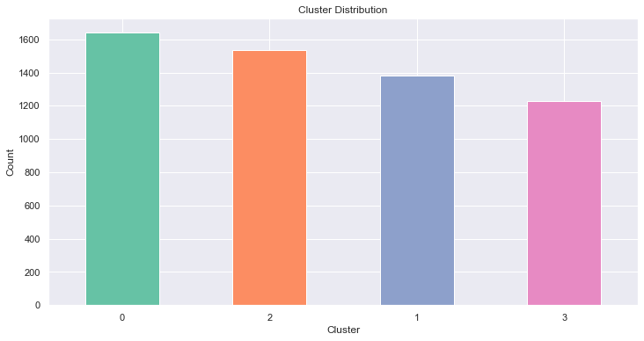
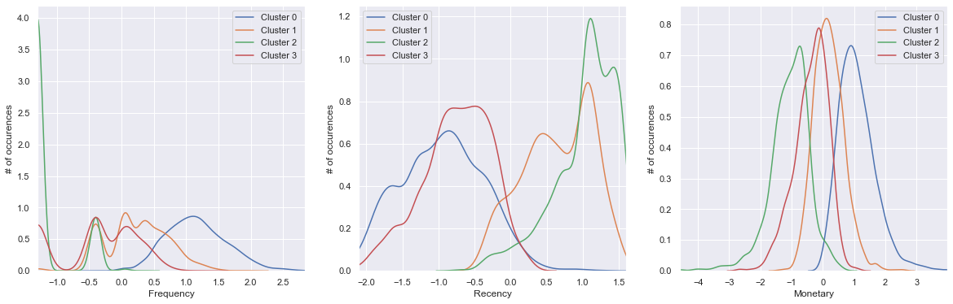
Customer Cluster Analysis
Cluster 0 - Loyal Customers:
- Largest group, highest spenders, frequent transaction
- Last transaction: 34 days ago.
- Action: Consider rewarding with free shipping.
Cluster 2 - High Value, Less Frequent:
- High spenders but infrequent visits.
- Potential to migrate them to regular customers.
- Action: Engage with new deals and product suggestions.
Cluster 3 - Occasional Shoppers:
- Moderate spending, less frequent orders.
- Last purchase: few months back.
- Profile: Intermittent shoppers.
Cluster 1 - Inactive Customers:
- Minimal spending, long absence since last purchase.
- Likely churned.
- Action: Re-engagement strategies needed.
Notes:
About the clusters identified, Cluster 0 is the core customer base: high spenders and frequent shoppers, with a recent purchase history. Offering perks like free shipping could enhance their loyalty.
Cluster 2 comprises significant spenders who haven't visited recently. We can re-engage them with fresh product launches and exclusive deals.
Cluster 3 represents occasional shoppers: moderate spenders with irregular shopping patterns.
Cluster 1 is a challenge. Minimal engagement in both spending and frequency, with a long gap since their last purchase. Crafting a unique re-engagement strategy is essential.

Slide 12
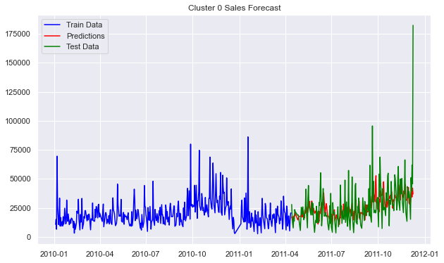
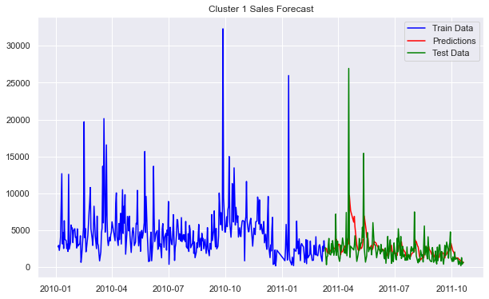
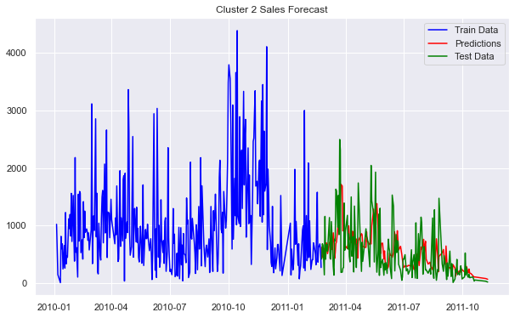
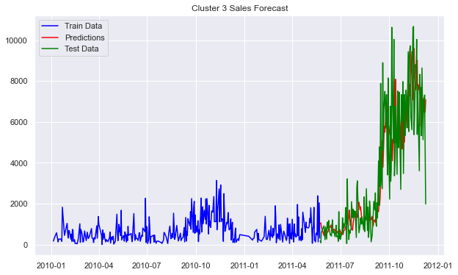
Train & Evaluate the Model
- Create daily sales data for each cluster
- Split train and test sets
- Use ARIMA to fit and forecast sales
- Use MSE to evaluate the performance of models for each cluster
Notes:
To forecast the sales:
I aggregated daily sales for each cluster. Then, Segmented the data into training and testing.
I Used ARIMA, a proven method for time series, which handles trends and seasonality effectively
To Validated the forecasts, I use Mean Square Error metric.
The charts on the right display the training results across different clusters

Slide 13
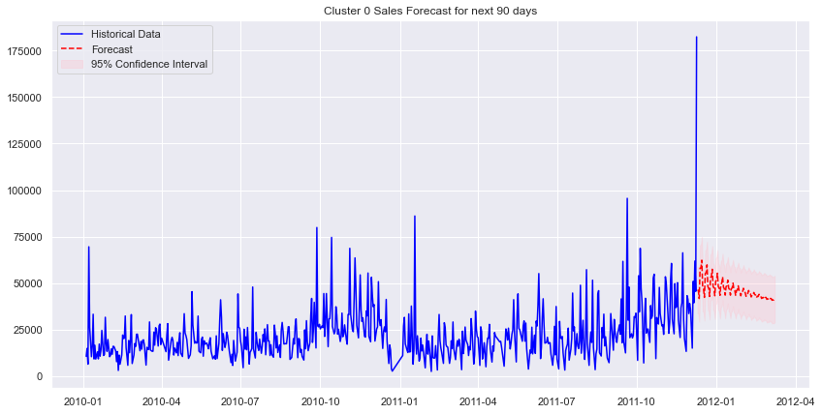
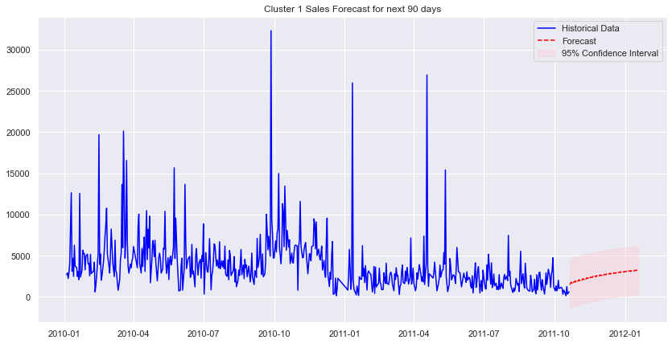
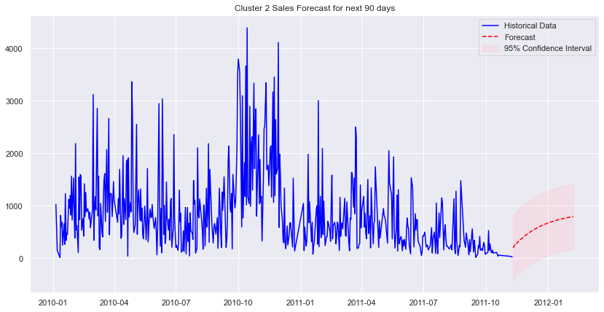
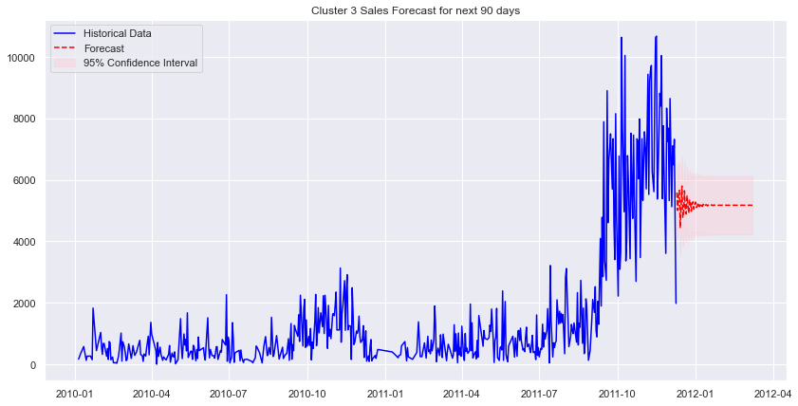
Forecast Sales in next 90 days
Sales Forecast Summary:
The sales forecasted drop from 2011-12-10 to 2012-03-08 across all clusters could be attributed to post-holiday effects, inventory shortages, or shifts in market conditions.
- Cluster 0: Expecting a decrease in sales, then stabilizing towards the end.
- Cluster 1: Slight decline in sales is forecasted.
- Cluster 2: Steady drop anticipated over the period.
- Cluster 3: Initial stability followed by a slight decrease in sales.
Notes:
After training and tuning the model, I create a sales prediction for the next 90 days:
Overall, I predict a sales drop from December 2011 to March 2012. Possible causes include post-holiday effect, inventory shortages, or market shifts.
For specifics:
Cluster 0 shows an initial sales dip, then stabilization.
Cluster 1 indicates a mild decline.
Cluster 2 foresees a consistent drop.
Cluster 3 starts stable, then slightly decreases.

Slide 14
Difficulties in the challenge
- Data Complexity: With over a million transactions between 2009 and 2011, handling and processing the data proved challenging.
- Seasonality Impact: The high business volume during the UK's peak holiday seasons (October to December) made it difficult to distinguish between seasonal spikes and consistent sales patterns.
- Forecasting for Clusters: Diverse purchasing behaviors in each cluster required specialized forecasting, complicating predictions due to factors like seasonality and return rates.
Notes:
I faced three main challenges analyzing customer data:
Data Complexity: I dealt with over a million transactions data, posing significant handling and processing issues.
Seasonality Impact: The business surge during holidays made it hard to anticipate growth from seasonal spikes.
Clustered Forecasting: Each customer group had distinct behaviors, requiring tailored forecasting, compounded by factors like seasonality and return rates.

Slide 15
Future Analysis Recommendation
1. Deepening Customer Insights
- Dive deeper into individual customer behaviors within segments.
- Explore psychographic attributes, like motivations and preferences, to further refine segments.
2. Enhancing Forecasting Techniques
- Incorporate advanced machine learning models beyond ARIMA, such as LSTM or Prophet, for improved accuracy.
- Test ensemble techniques by blending multiple forecast models.
3. Expanding Feature Engineering
- Develop new features based on purchasing behaviors, such as preferred product categories, or seasonality preferences.
- Evaluate the impact of external factors, like marketing campaigns or economic trends, on sales.
4. RMF & Kmeans Optimization
- Re-evaluate cluster stability over time and adjust Kmeans parameters.
- Explore alternative segmentation methods like hierarchical clustering or DBSCAN to ensure optimal segmentation.
5. Impact of Strategy on Sales
- Post-implementation review of strategies to determine real-world effectiveness.
- Assess the correlation between forecasted vs. actual sales after executing the strategy.
Notes:
Some recommendations that could potentially be useful for future analysis.
1. Dive deeper into individual customer behaviors within segments
2. Incorporate advanced machine learning models beyond ARIMA to improved accuracy, such as LSTM or Prophet
3. Develop new features based on purchasing behaviors.
4. Explore alternative segmentation methods like hierarchical clustering or DBSCAN
5. Evaluate the correlation between forecasted vs. actual sales after executing the strategy

